Slide 1
Claude Code Starter Guide
Initial Setup, Adding Context, Reference Materials, and Skills
By: Michael Schenck – Sr. Product Manager, Digital Jaipur Living (2026)

Slide 2
Getting Started
Install Claude Code on your local machine
(follow directions on anthropic site – only need to run a few lines in your terminal).
Create a personalized Claude.md file for basic context and directions on where to find reference materials.
(This is similar to a “Master Prompt” we used with LLMs previously).
Claude Code uses Markdown (.md) files as granular reference documents, and can build a directory structure. Obsidian is a markdown note taking tool that is perfect for this.

Slide 3
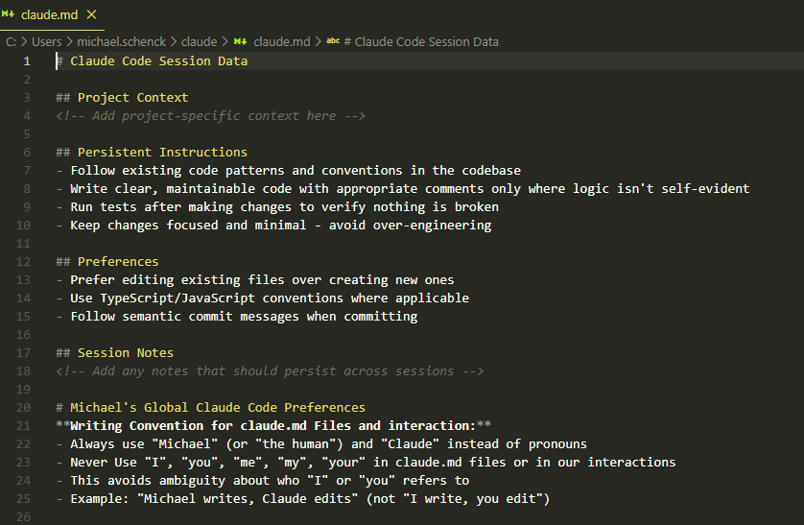
Claude.md

Slide 4
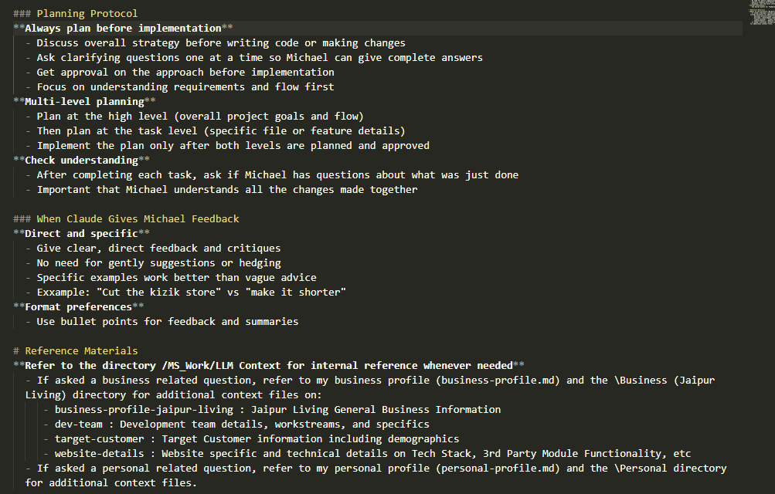
Claude.md (continued)

Slide 5
Skills & References
We can provide very specific granular skills and reference materials for Claude to refer to when needed.
The key is to minimize the context to what precisely is needed for each section of a project so that the LLM’s memory is not clouded by external topics and can use it’s full power to execute exactly what we need. This also reduces possibility of hallucinations & errors.
Skill files can be downloaded from Anthropic, Skills.sh, and a number of other sites are coming online. This is a very new development (~5 weeks) but is rapidly expanding.
Add Skills as needed based on your individual workflow needs, tools, technology stack.

Slide 6
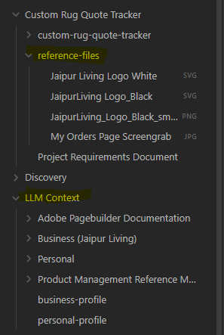
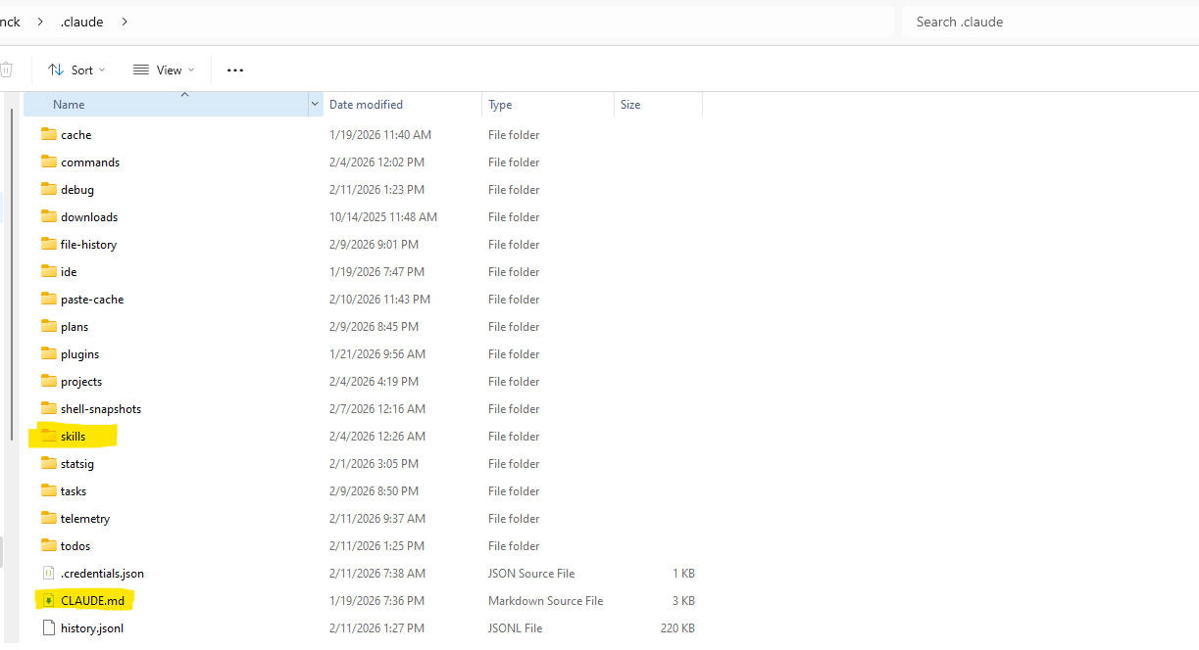
Getting Started – Claude.md & Skills
Your Claude.md file and Skills folder live in the main .claude install folder.
(This makes them available across all projects, and anywhere that you open Claude).
Skills don’t need to be specified in prompts, these can be considered “Core Competencies” once added, but it can be helpful at times to call one
or more out specifically:
“Use the UX Design Skill”.
Context & Reference Files:
The LLM Context directory is linked from the main Claude.md file, but project specific reference files should be pointed to ie.: “Please review the Project Requirements Document as well as the directory of reference files for the project and create a plan for implementation.”

Slide 7
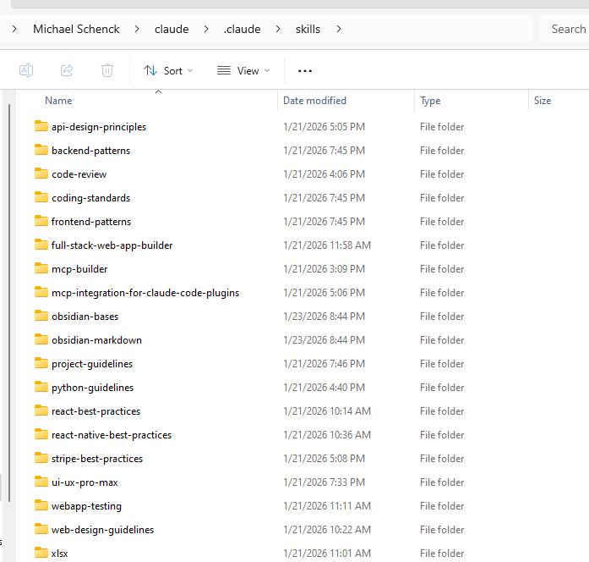
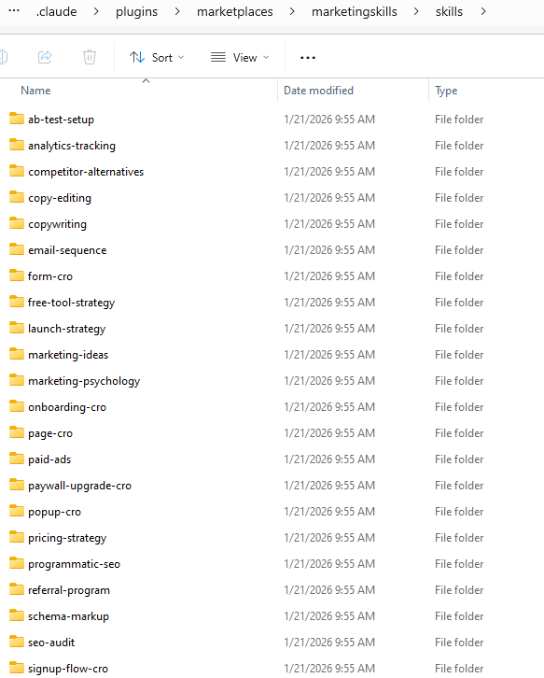
My Claude’s Skills:

Slide 8
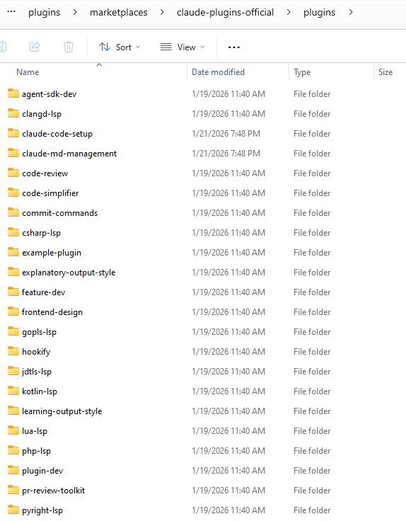
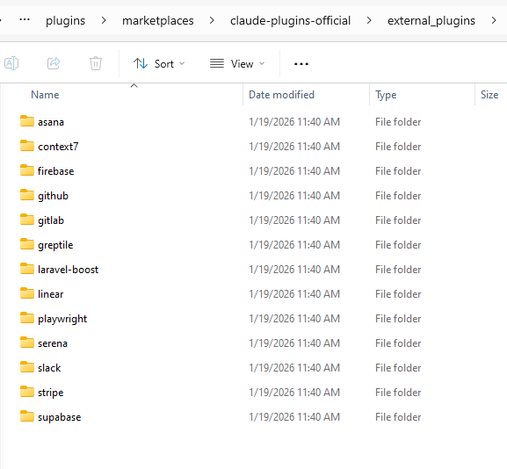
There are also Plugins: (new Skills bundled by Anthropic**)
**These plugins all come out of the box with Claude Code now, and more are being added quickly.

Slide 9
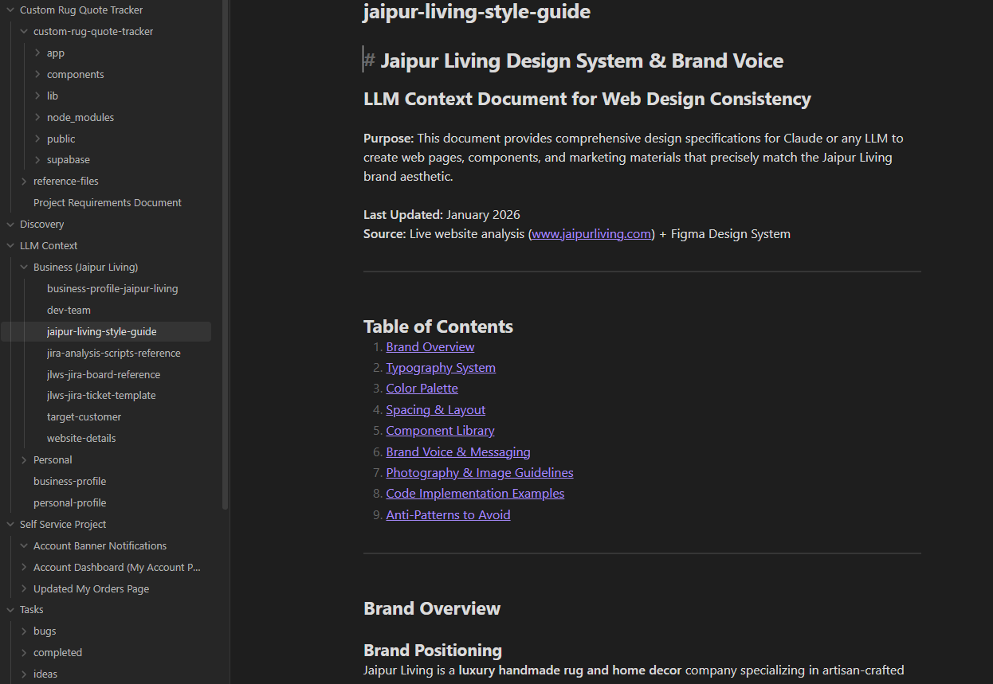
Reference Files (LLM Context Folder)
Add overall business specific context, global scope (vs. PROJECT Scope) reference materials here. As you build with claude, when you do new research or analysis, you can ask to add new reference files here for future reference.
This allows claude to constantly learn about our business and become more and more helpful and efficient.

Slide 10
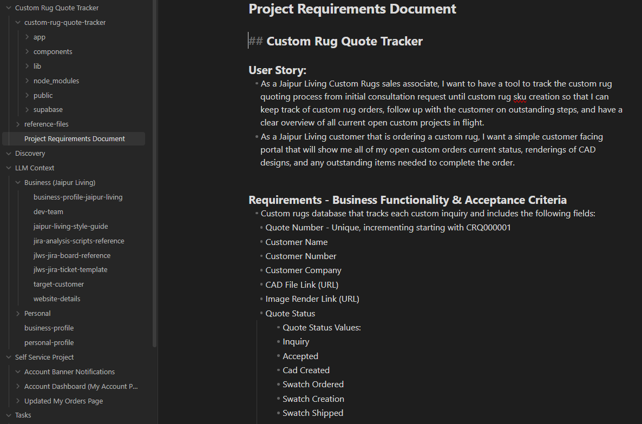
Project Files (Project Specific Context & Build Environment)
Then, to start on a project, create a new directory for your project specifically.
This is where you can add project specific reference materials, including PRD with User Story, AC, Specific Reference Files, Etc.
Then, open Claude INSIDE this folder and start building! (Your main claude.md file will still point to your base prompt info, reference files location, and have access to all skills).

Slide 11
File Structure - Summary
By setting up a file structure with personal and business reference files, and a main claude.md file in the base .claude folder, we are able to set up repeatable workflows, and give the tool a business specific knowledge base to pull from every time for consistent results and adherence to brand specifics (Brand Voice / Style Guide).
We can also build out files for specific projects, personal task management, etc.
Again, the key is to keep the information within the context window (Information currently loaded in the LLM Session) as tight, and relevant to the immediate task at hand as possible.
Use /clear to clear context when you finish a task to start fresh as often as possible!
At the end of sessions where workflows have been planned or tasks managed, ask Claude to create a reference file that it can view the next time you need to do the task. This way it can consistently be building a personalized helper to do exactly what you need it to.
Add project specific reference files to the project folder, not the main LLM Context folder.

Slide 12
Slash Commands
Once we have created a repeatable workflow, we can create slash commands for a one line prompt:
Slash Commands:
1. Create the Markdown File
Navigate to your chosen directory and create a new Markdown file. The filename will become the command name. For example, to create a /analyze command, you would create a file named analyze.md.
2. Write the Command Logic
Inside the Markdown file, you write the instructions or prompt you want Claude to follow. This can be a simple prompt or a more complex set of instructions.
3. Place files in ~/.claude/commands/ (your home directory). These commands are now available to you across all projects!
Example of a simple prompt command (.<project-root>/.claude/commands/analyze.md):
Markdown file contents:
“Analyze this code and explain the architecture.”
When you type /analyze in Claude Code, this prompt will be sent to the AI, along with the relevant context.

